Slide 1
Spheroids

Slide 2
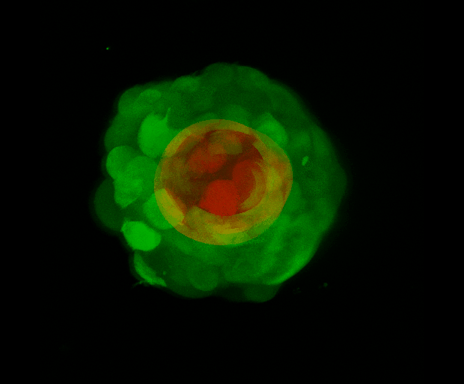
Inner vs Outer

Slide 3
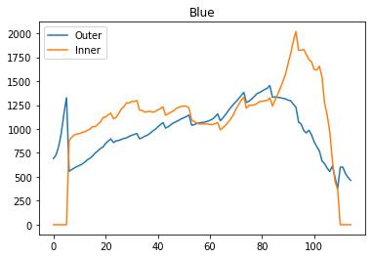
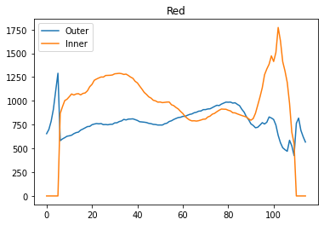
Average Fluorescence

Slide 4
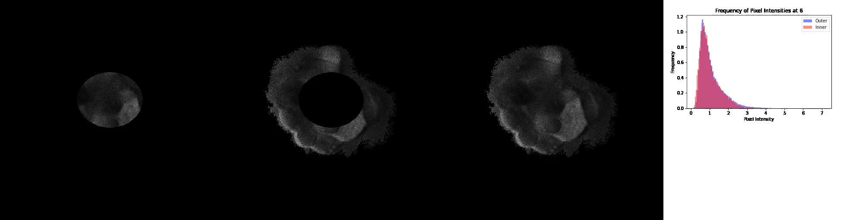
Pixel intensity
Notes:
Same for 0–16. 16-24 can see more spread out distribution for inner. 24-36 can see two populations for inner. 36-64 more spread out. 64-98 about same distribution with heavier tail for outer.

Slide 5
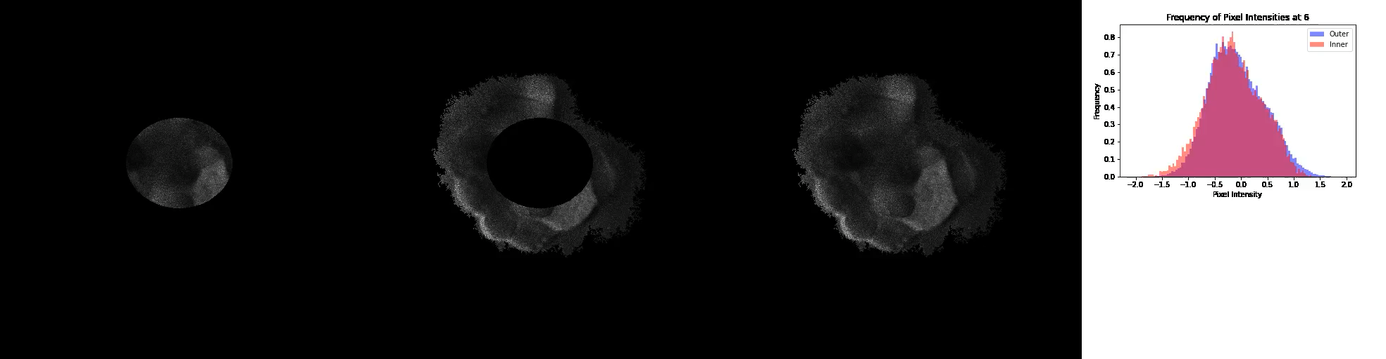
Log scale pixel intensity

Slide 6
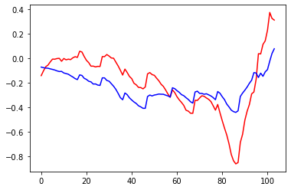

Log scale pixel intensity with mean

Slide 7
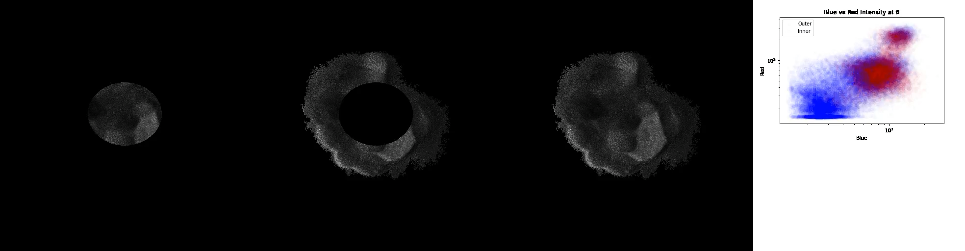
Scatter plots

Slide 8
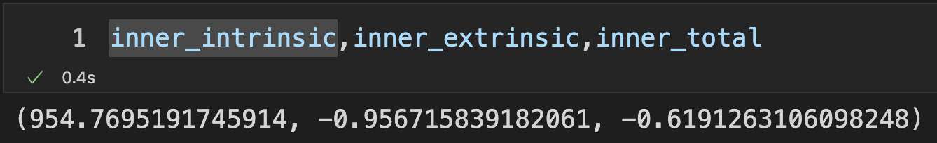
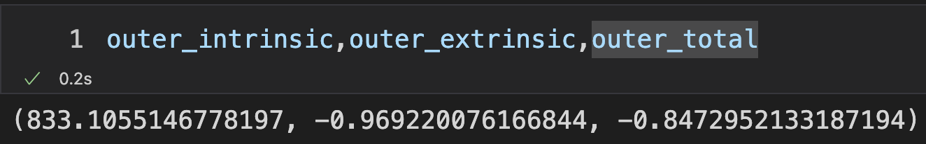
Intrinsic and Extrinsic noise

